Slide 1
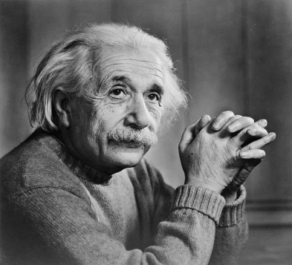
ATOMIC ENERGY CENTRAL SCHOOL-04, RAWATBHATA.
CLASS : XII
SUBJECT : PHYSICS
CHAPTER : 11
“DUAL NATURE OF RADIATION AND MATTER”.
MODULE-1
Presented By : Soniya Moreshwar Sayam
(PGT-PHYSICS)

Slide 2
Topics to be discussed ……
Electron Emission
Methods of Electron Emission
Work Function
Photoelectric Effect
Experimental study of Photoelectric Effect.
Effect of Intensity on Photoelectric current.
Effect of Collector Potential on Photoelectric current:
(when Intensity & Frequency of radiation is fixed.)

Slide 3
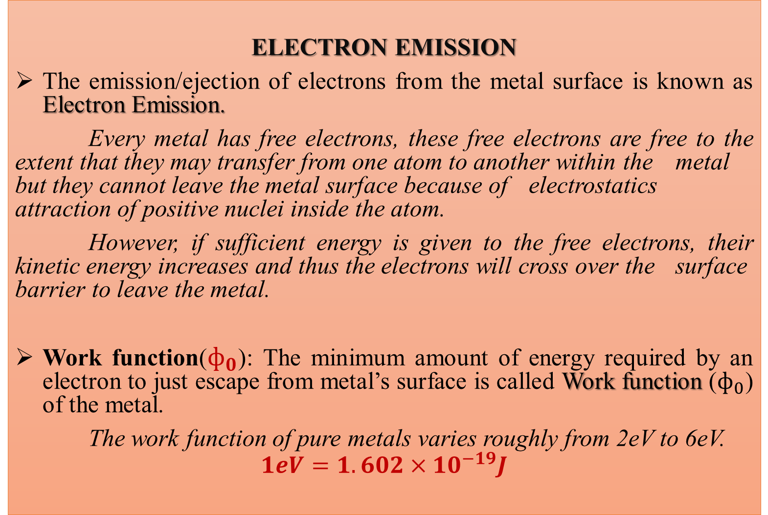
ELECTRON EMISSION
The emission/ejection of electrons from the metal surface is known as Electron Emission.
Every metal has free electrons, these free electrons are free to the extent that they may transfer from one atom to another within the metal but they cannot leave the metal surface because of electrostatics attraction of positive nuclei inside the atom.
However, if sufficient energy is given to the free electrons, their kinetic energy increases and thus the electrons will cross over the surface barrier to leave the metal.
Work function($ф_{0}$): The minimum amount of energy required by an electron to just escape from metal’s surface is called Work function ($ф_{0}$) of the metal.
The work function of pure metals varies roughly from 2eV to 6eV.
$$1eV=1.602×{10}^{−19}J$$

Slide 4
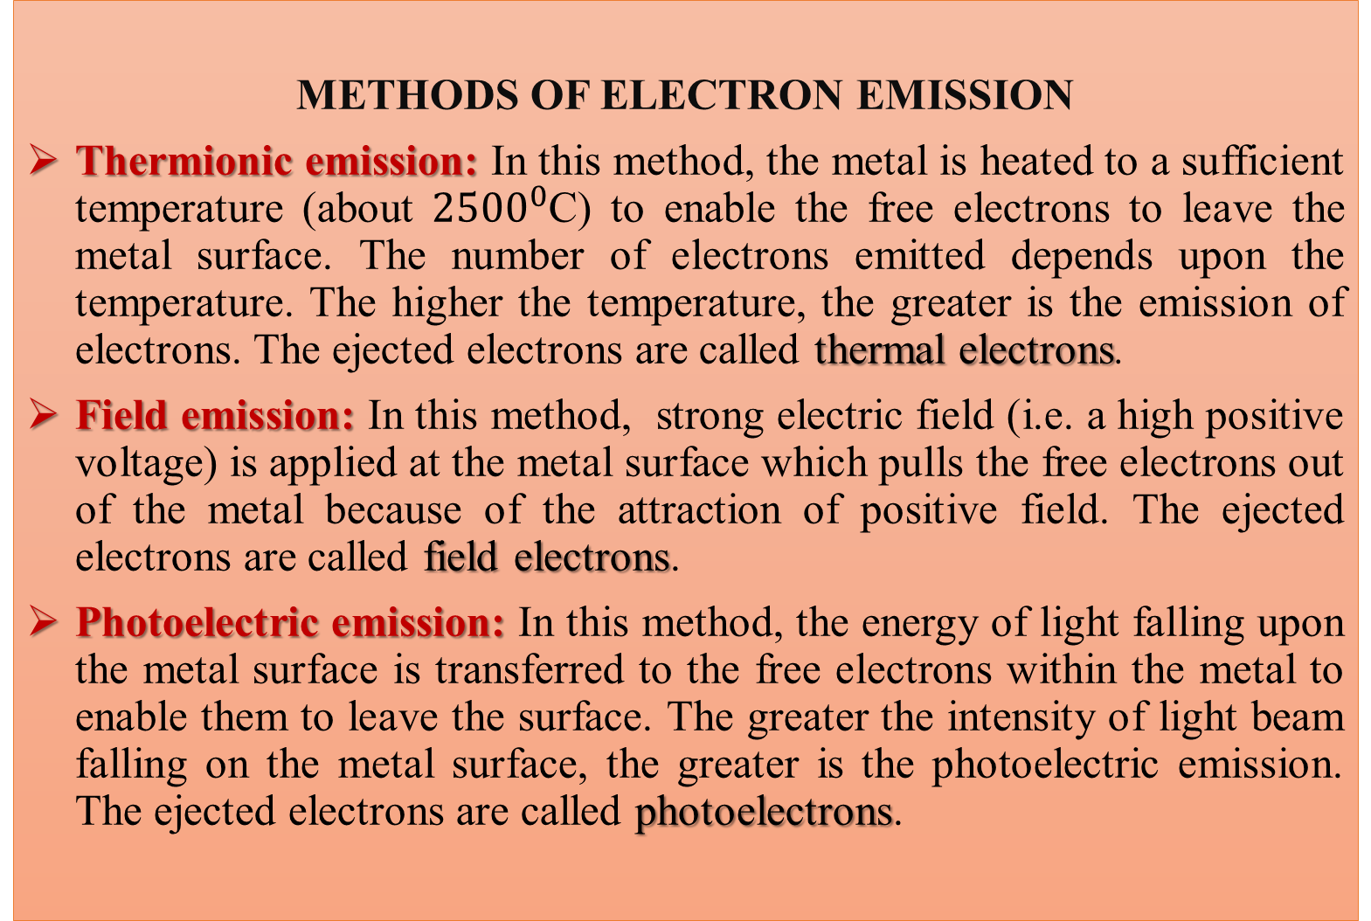
METHODS OF ELECTRON EMISSION
Thermionic emission:In this method, the metal is heated to a sufficient temperature (about ${2500}^{0}$C) to enable the free electrons to leave the metal surface. The number of electrons emitted depends upon the temperature. The higher the temperature, the greater is the emission of electrons. The ejected electrons are called thermal electrons.
Field emission:In this method, strong electric field (i.e. a high positive voltage) is applied at the metal surface which pulls the free electrons out of the metal because of the attraction of positive field. The ejected electrons are called fieldelectrons.
Photoelectric emission: In this method, the energy of light falling upon the metal surface is transferred to the free electrons within the metal to enable them to leave the surface. The greater the intensity of light beam falling on the metal surface, the greater is the photoelectric emission. The ejected electrons are called photoelectrons.

Slide 5
METHODS OF ELECTRON EMISSION
Secondary emission: In this method, a high velocity beam of primary electrons strikes the metal surface. The intensity of secondary emission depends upon the emitter material, mass and energy of bombarding particles. The ejected electrons are called secondary electrons.

Slide 6
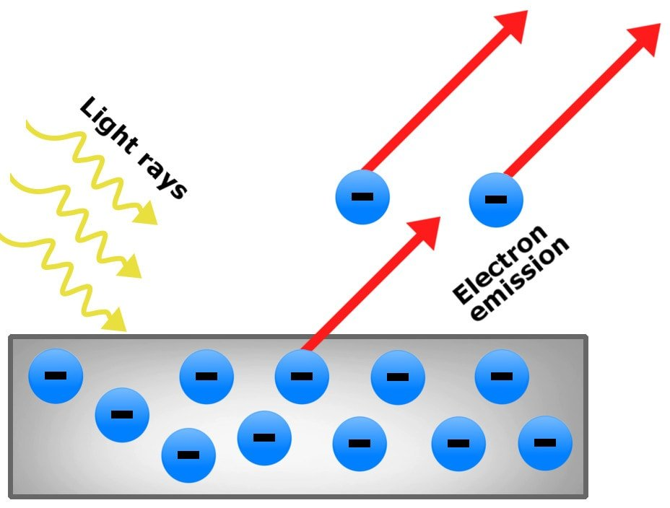
PHOTOELECTRIC EFFECT
The phenomena of emission of electrons from a metal surface, when radiations of suitable frequency is incident on it, is called photoelectric effect.
Alkali metals : Li, Na, K, Cs & Rb - Highly photosensitive - Emit electrons even with visible light.
Metals : Zn, Cd, Mg, Al, etc
- Ultraviolet light.
Heavy Metals : X-rays.
The electrons emitted by this effect are called photoelectrons and the current constituted by photoelectrons is known as photoelectric current or photocurrent.
It was discovered by Heinrich Hertz in 1887 during his EM waves experiments.

Slide 7
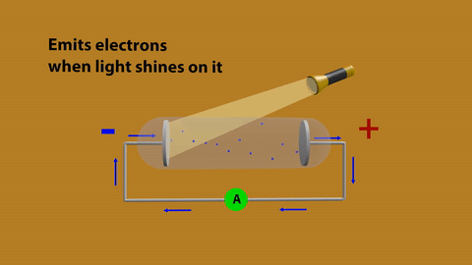
PHOTOELECTRIC EFFECT

Slide 8
EXPERIMENTAL STUDY OF PHOTOELECTRIC EFFECT :
Philipp Lenard studied the photoelectric effect practically.
Fig. shows his experimental setup
C – Metallic cathode
A – Metallic Anode
W – Quartz Window
When light of suitable frequency falls on the metallic cathode, photoelectrons are emitted. These photoelectrons are attracted towards the +ve anode and hence photoelectric current is constituted.

Slide 9
EFFECT OF INTENSITY OF LIGHT ON PHOTOELECTRIC CURRENT:
Current is number of electrons passing through a cross section in unit time.
As Intensity increase↑ : No of electron emitted increase↑ : Current ↑
Photocurrent ∝ Intensity as the frequency & accelerating potential is fixed.
Photoelectric current
Intensity of light

Slide 10
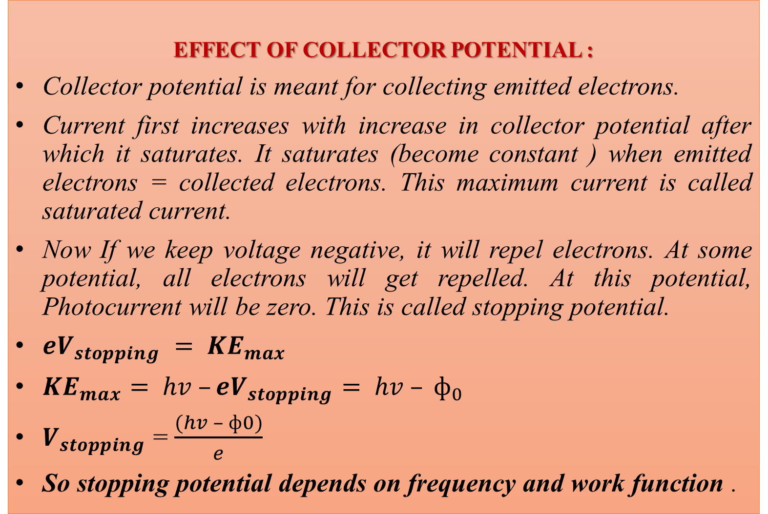
fffsssssssssssssssssssssssssssVV

Slide 11
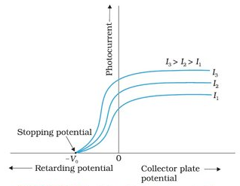
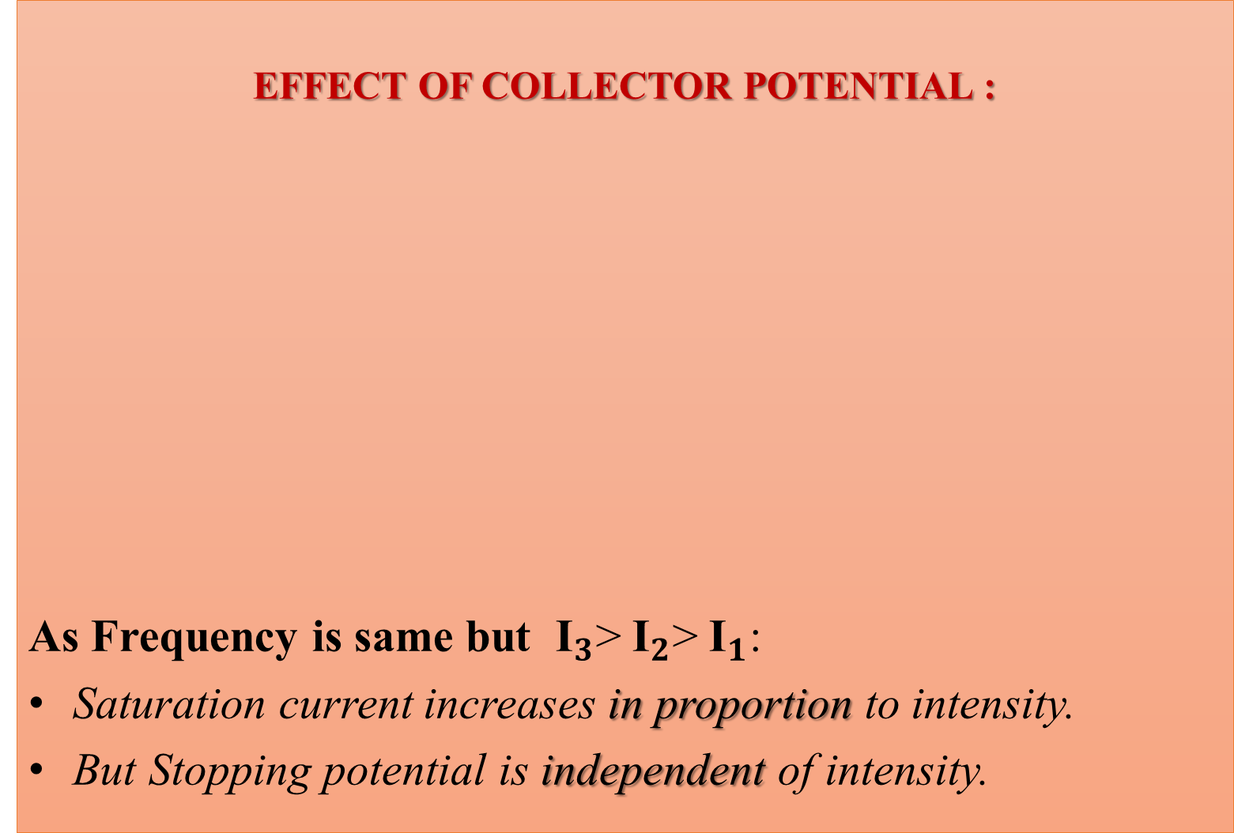
EFFECT OF COLLECTOR POTENTIAL :
As Frequency is same but ${\text{I}}_{3}$>${\text{I}}_{2}$>${\text{I}}_{1}$:
Saturation current increases in proportion to intensity.
But Stopping potential is independent of intensity.

Slide 12
TO BE CONTINUED…
THANK YOU FOR WATCHING!

